Slide 1
Managing Compressed tar Archives

Slide 2
File compression
File compression is a routine task for most of the Administrators and normal users, to save disk space and to move data from one location to another location
tar utility was developed to get sequential data backup and it was stored in magnetic tape drives

Slide 3
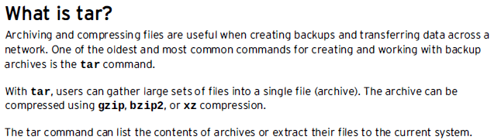

Slide 4
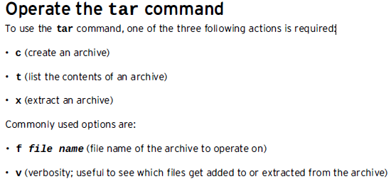

Slide 5
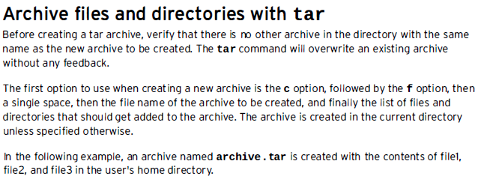


Slide 6
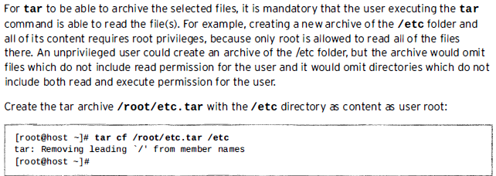

Slide 7
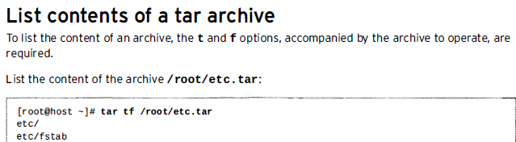

Slide 8
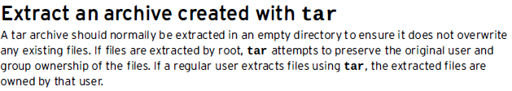

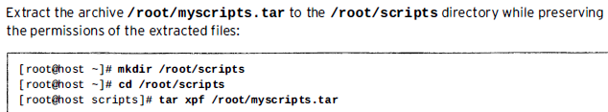

Slide 10
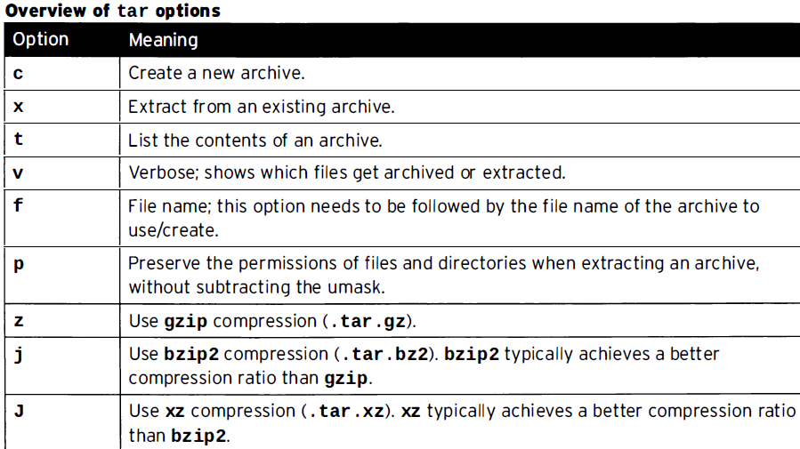

Slide 11
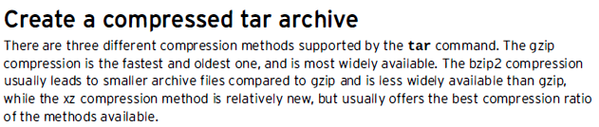
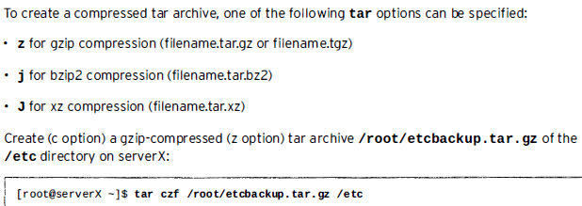

Slide 12



Slide 13
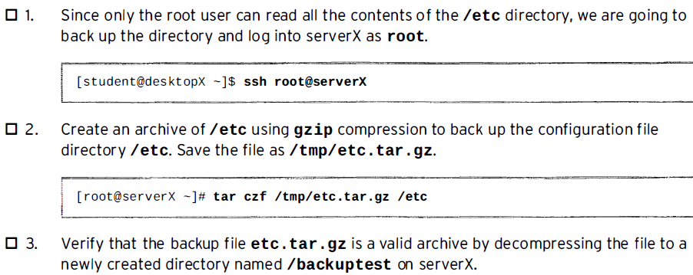
Practice: Backing Up and Restoring Files From a tar Archive

Slide 14
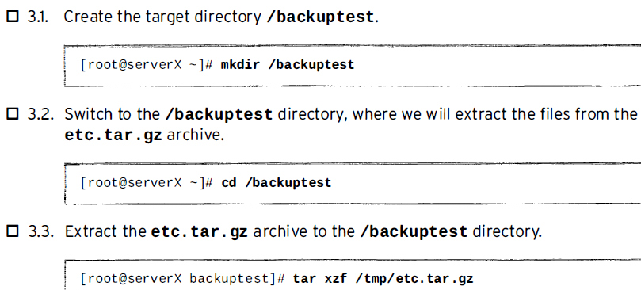
Practice: Backing Up and Restoring Files From a tar Archive

Slide 15
1. Extract a single file from tar, tar.gz, tar.bz2 file
$ tar xvf archive_file.tar /path/to/file
2. Verify files available in tar using option -W
$ tar cvfW file_name.tar dir/
Estimate the tar archive size
estimates the tar file size ( in KB ) before you create the tar file.
$ tar -cf - /directory/to/archive/ | wc -c

